Slide 1

GLA UNIVERSITY, MATHURA
Container Deployment Manager
Submitted By (Section G): Ankit Tyagi (2315000314) Ankush Pathak (2315000324) Anshul Sharma (2315000350) Aonik Yadav (2315000403)
Arjoo (2315000412) Submitted To: Mr. Ayush Kumar Department of Computer Science and Engineering GLA University, Mathura

Slide 2

Container Deployment Manager
A sophisticated, multi-tenant container orchestration platform executing zero-downtime blue-green deployments with role-based access control and live monitoring.
OPEN SOURCE
MIT LICENSE

Slide 3






Key Features
Blue-Green Deployments
Tenant Isolation
Zero-downtime updates via smooth physical port swapping.
Isolated orchestration domains per registered user.
Admin Control Center
Live Log Streams
Top-level visibility over user fleets and cluster-wide metrics.
Real-time container logs streamed to the UI via Server-Sent Events (SSE).
Health Validations
Secure Auth
Strict startup health-checks before traffic proxy rerouting.
JWT-based session management and bcrypt password hashing.

Slide 4
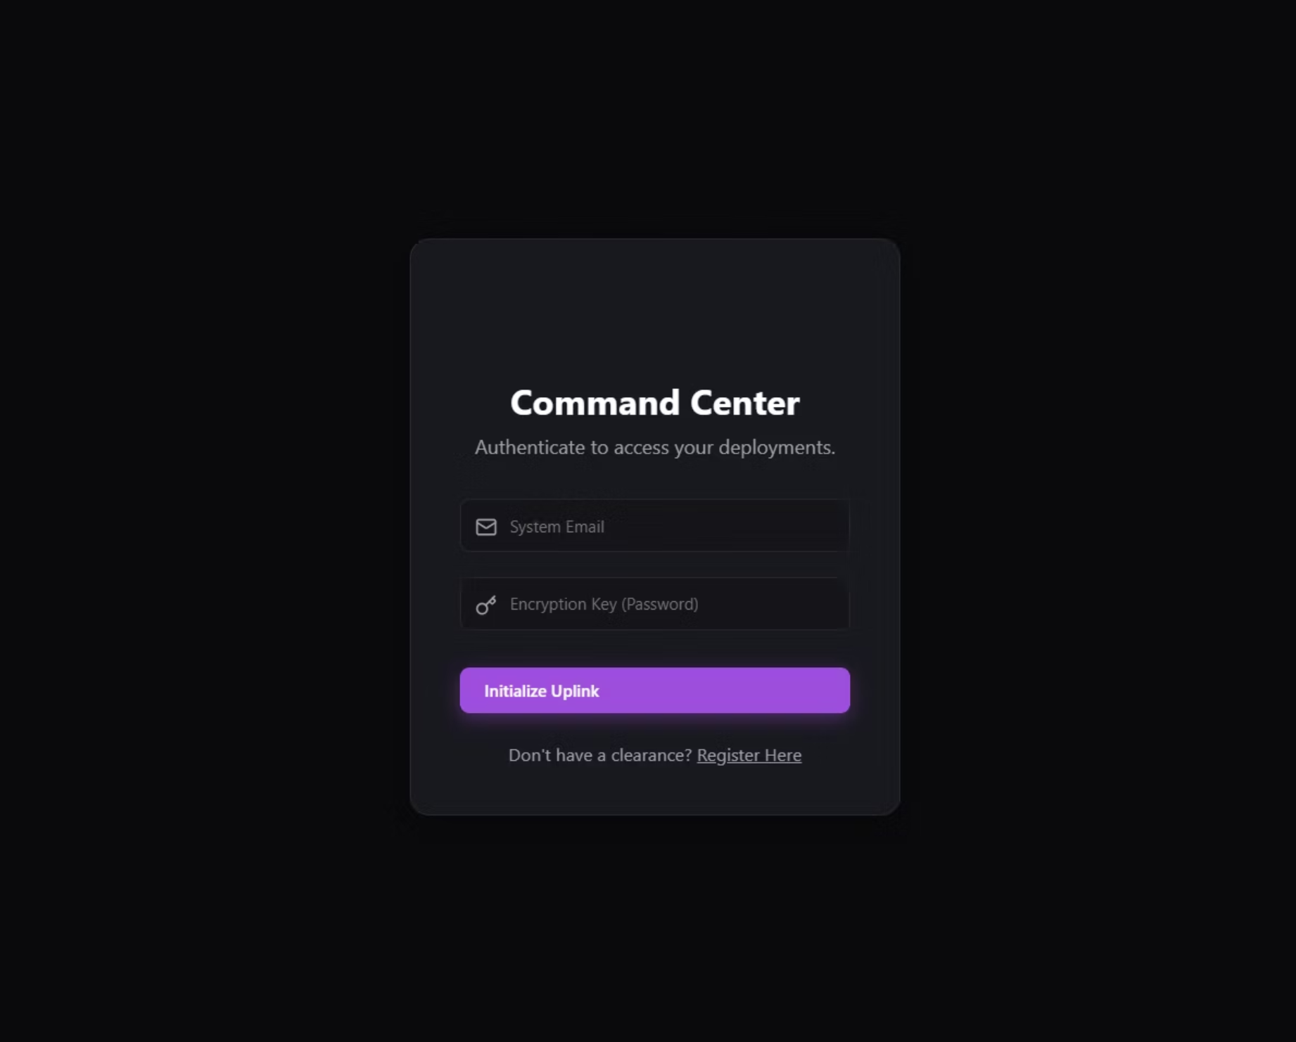
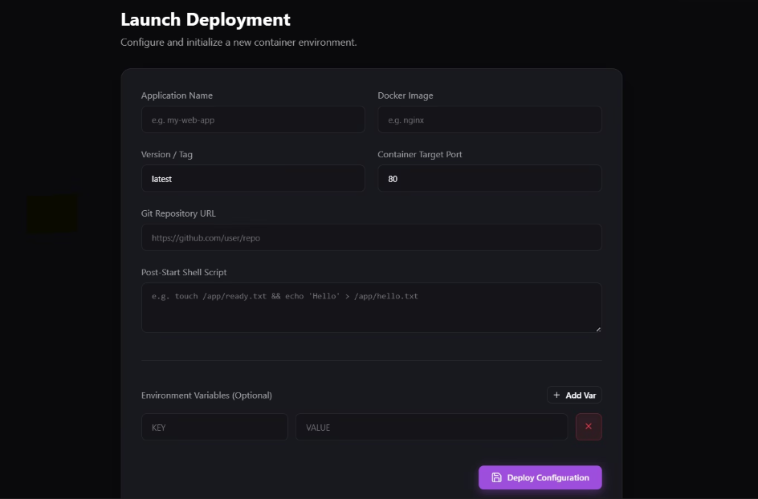
INTERFACE
Command Center & Deployment Console
Launch Deployment — configure application name, Docker image, version tag, target port, Git repo URL, and environment variables.
Login Gateway — authenticate to access your deployments.

Slide 5
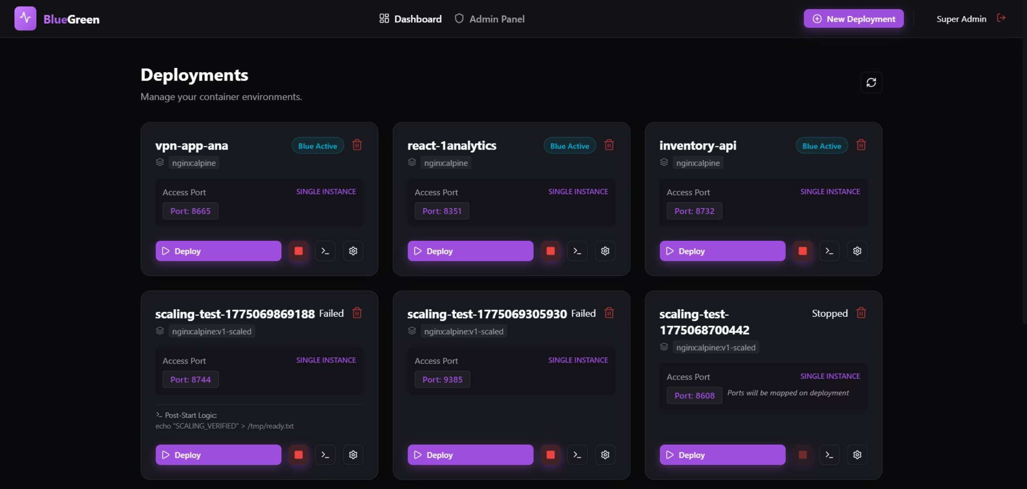
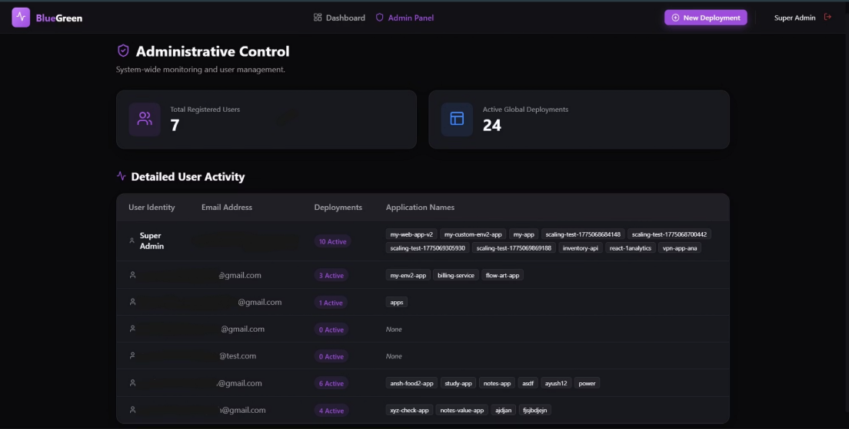
INTERFACE
Dashboard & Admin Console
Administrative Control — system-wide monitoring showing 7 registered users and 24 active global deployments.
Deployment Orchestration Hub — active ports, container status, and real-time telemetry at a glance.

Slide 6

How It Works: The Blue-Green Shuffle
Zero drop-offs guaranteed during every upgrade through strict container lifecycle management.

Slide 7
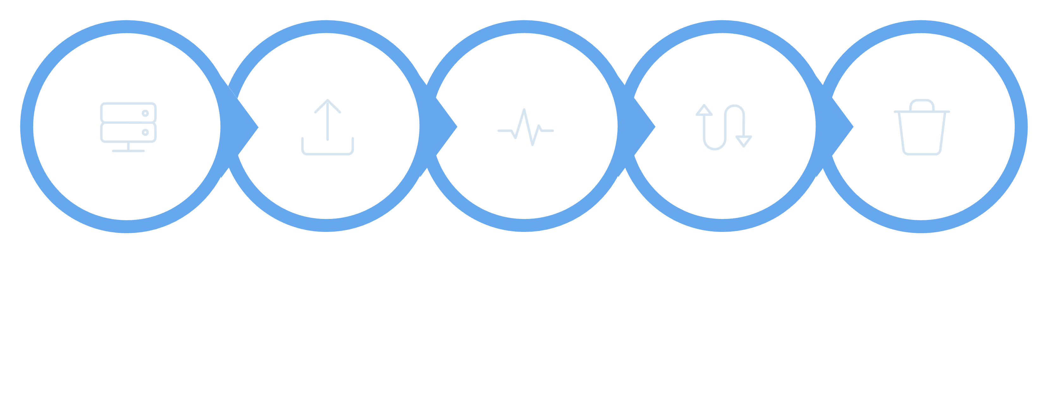
Active
Launch
Health
Swivel
Cleanup
The orchestrator continuously pings the new container until it confirms stability, then instantly swivels the internal reverse proxy — users experience no interruption.

Slide 8

Tech Stack
Frontend
React 18 + Vite · Custom Vanilla CSS (Glassmorphism & Gradients)
Backend
Node.js + Express 5.x · Node http-proxy
Database
MongoDB + Mongoose
Auth & Orchestration
JWT + bcryptjs · Native Docker Engine API

Slide 9
API Reference
Auth — /api/auth
Deployments — /api/deployments
POST
/register
Register a new user
GET
/
List all deployments
POST
/login
Authenticate & obtain JWT
POST
/:id/deploy
Trigger zero-downtime launch
GET
/me
Retrieve active user payload
POST
/:id/stop
Emergency halt
GET
/:id/logs
SSE live log stream
DELETE
/:id
Eradicate deployment

Slide 10
Setup in 6 Steps
Configure .env
1
Set PORT=31234, MONGO_URI, and JWT_SECRET.
Install Backend
2
Run npm install in the root directory.
Start Backend
3
npm start → Engine active on localhost:31234.
Install Frontend
4
cd frontend && npm install
Start Frontend
5
npm run dev → UI live at localhost:5173.
Enter Command Center
6
Register an admin account and start executing deployments!

Slide 11


Performance Tips & License
⚡ Docker Memory
🐋 Use Alpine Images
Allocate at least 4GB RAM in Docker Desktop when running multiple images.
Prefer lightweight tags like node:18-alpine to keep deployment times short.
🧹 Clean Images
Run docker system prune periodically to clear orphaned images.
MIT License — Free to use, fork, and orchestrate!

